Slide 1


Project Title : Development of Judo of Training cost Calculator
Module Project
Module: Programming Foundations
Course: Applied Degree in Software Engineering
Learner Name
Enrollment ID
Start Date : 14th Dec 2022
End Date : 19th Jan 2023
Submission Date : 19th Jan 2023
: Syavira Rizki Ariani
:BDSE-STTB-LS-05328
Presentation Date :

Slide 2

Document History
Version Number | Effective Date of release | Summary of Included Changes | Author
1
2

Slide 3
Contents
Project Definition
Project Deliverables
Project Milestones & Tasks
Project Environment
Tools
Project Design
Classes & Methods
Steps from Coding to Execution
Development Process
Coding Standards
Milestone Feedback & Action Taken
Project Results
Proposed Improvements

Slide 4
1. Project Definition
AQDS (AQ Digital Solutions) company which is offer software solution all sizes and various industries with the aim of simplifying programming, and achieve the goals desired by company clients. In this case North Sussex Judo has been requested to AQDS to solve their program. North Sussex Judo has specializes which providing training sessions to members of the local community. Regardless from of their level of experience.they cater to people of all ages and skill levels (expert to beginner).They need help For make an easier in this program. and me as Junior software AQDS Company will make the application for the athletes or the members that comfortable to access it, and will help for join the training that they want it. And also need to design interface more like understable and make everybody understood for that.
Project Objective
Proposed Solution
Before we reach out the clients goal, we must discussed how difficulties such as who people need join is unpredictable, but we found the solutions within few requirements its First, functional requirements namely data input, calculation method for determine total cost of training , and giving the output.Second, Bussiness requirement for client company, get benefit from this program.And make automate the registration, etc. Third, Non-functional Requirements are basically system properties. Like what abilities does the software have. Fourth, environment requirements for ensure operation of the application.

Slide 5
2. Project Deliverables
Project Deliverables
In this instance, North Sussex Judo has been asked to use a program that must estimate the monthly cost of training fees for its athletes. This program was created by entering data, which is made up of figures in each training session, including the session fee, and will be used as information to calculate the overall monthly cost.
The NSJ training cost calculator will be a program that allows users to input data about the athletes and calculates the total cost of training fees for the each months. The program will consist an athlete class. Three main method will be accepting the input. Calculating the total cost and display the results. And variable to store data, it also create the object to represent the specific athletes and have a unique instance for each object
List of Evidences

Slide 6
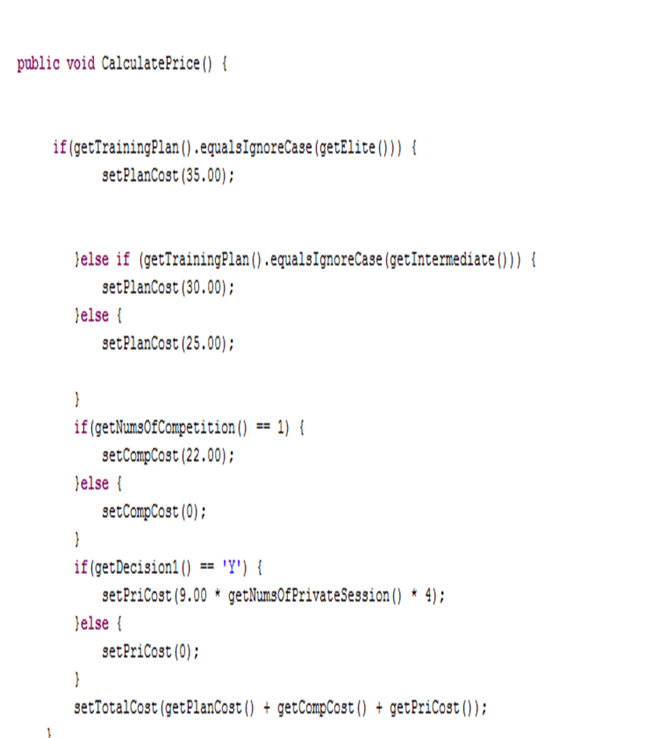
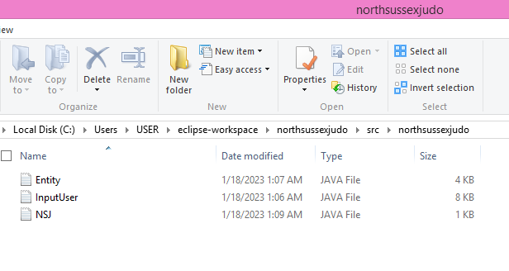

Slide 7
3. Project Milestones & Tasks
Project Task ID | Project Task Description | Project Milestone ID
1 | Create Requirement Specification | 1
2 | Develop Algorithm | 1
3 | Analysis and Design | 2
4 | Create the Application | 2
5 | Debug and Test the Application | 3

Slide 8
4. Project Environment
Technical Environment and Tools Used
Eclipse IDE (Tools for implement the program)
Jdk-11.0.17_windows-x64_bin
List of references
https://www.eclipse.org/downloads/

Slide 9
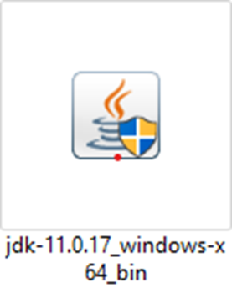
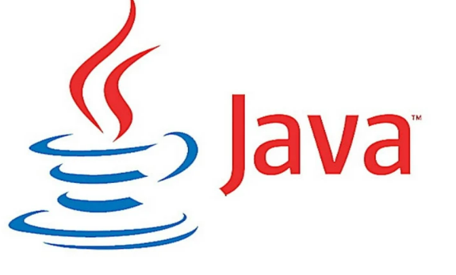

5. Tools
JAVA JDK
ECLIPSE IDE
Screen capture of various tools used

Slide 10
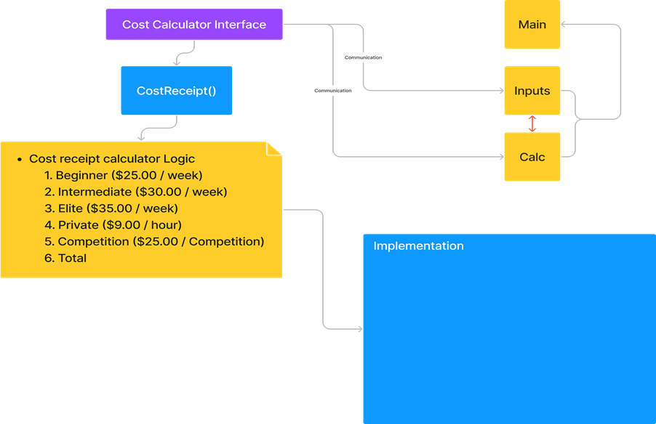
6. Project Design
System Design
a×b= x
x+c (if there are)=y
x+z (if there are)=i
x+c+z(if there are)=p
a=cost level
b =number of weeks / 4
c=private tuition
z=competition costs
Private tuition ( c )
c=9.00 × number of hours
Total (x & y & i & p )
Total is y if there are additional private tuition.
Total is x if there are no additional private tuition & competition.
Total is i if there are additional competition & no private tuition.
Total is p if there are additional competition & private tuition.

Slide 11
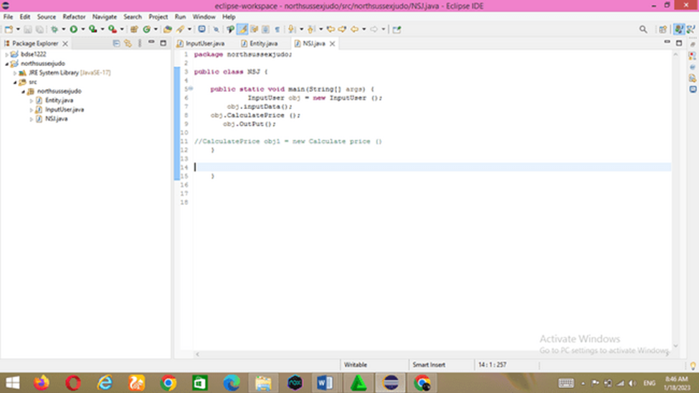
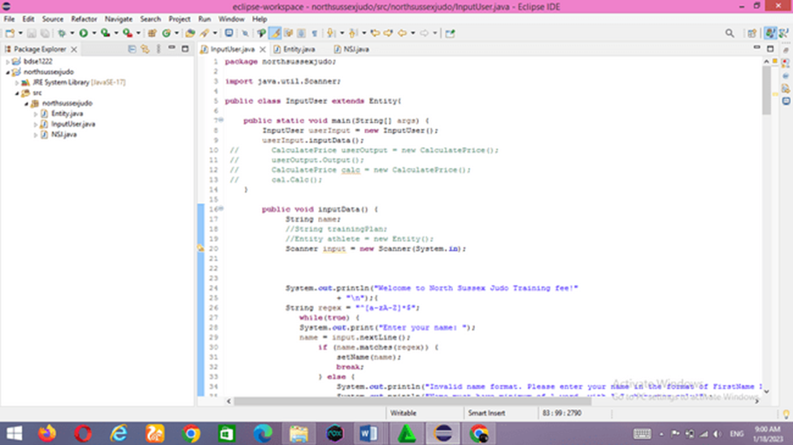
7. Classes & Methods
List of Classes & Methods used
Classes:
Java classes
NSJ.java
Entity.java
InputUser.java
Methods : Inheritance/encapsulation (with extends), String, constructor, setters and getters, double, ints, etc.
-

Slide 12
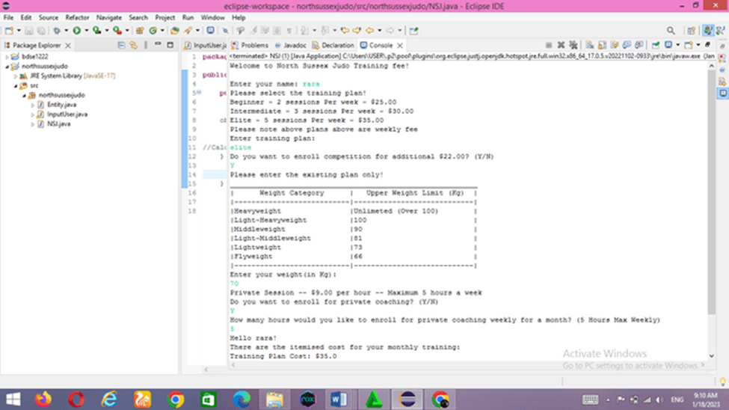
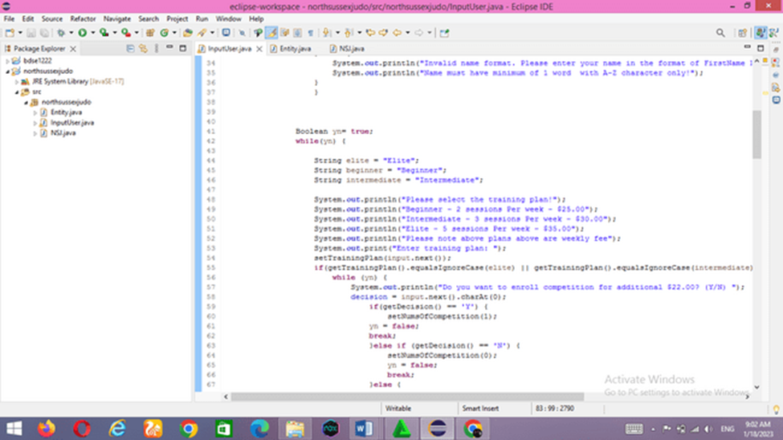
8. Steps from Coding to Execution
Application execution methods
SCANNING &EXTENDS DATA FROM PARENT CLASS (ENTITY CLASS)
USED METHOD INHERITANCE .
SYTEM PRINT STATEMENT OF DATA
OUTPUT =

Slide 13
9. Development Process
Development using IDE and Debugging Mode
Debugging is the process of finding and fixing bugs and errors in software source code. When software doesn't work as expected, computer programmers examine the code to determine the reason for the failure. Debugging can also mean a system that shows the flow of a program, sometimes referred to as a flowchart/process of a running program.
Debugging is the process of finding and eliminating program or system errors. A bug is an error or defect that prevents a program or system from working properly. Programs are usually written with very complicated and complicated code, so a small mistake can have a big impact on the whole program. Therefore, pre- and post-release debugging of your program is very important.

Slide 14
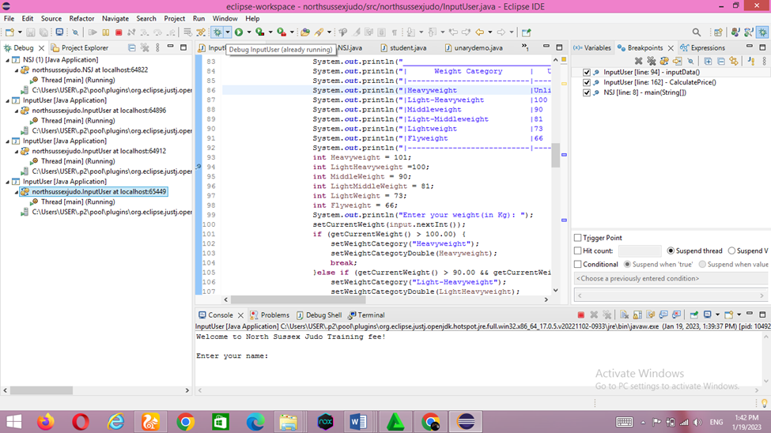
9

Slide 15

10. Coding Standards
Application of coding standards
Coding Standards for Methods: Usually method name should either be verb or verb noun combination starting with lower letter. If it contains multiple word than every inner word should start with uppercase.
GETTERS &SETTERS

Slide 16
Using Naming Standard
Class Members must be accessed privately
It is considered a good Java practice to keep the accessibility of class fields as inaccessible as possible. It is made to protect the fields. To achieve this, the private access modifier is the ideal choice. This practice is recommended to maintain encapsulation, one of the basic concepts of OOP. Although this is an extremely basic concept of object-oriented programming, many programmers who are new to it still do not properly assign class access modifiers and prefer to make it public for ease of use. understand.
Consider this class where fields are made public

Slide 17
11. Milestone Feedback & Action taken
Project Milestone ID | Milestone Feedback received from Tutor / Learning Facilitator | Action Taken (Yes / No)
1 | FA 1
 | TASK 1.1 Missing requirements, existing systems it requirements, existing system its limitations solutions approach | YES
 | 1.2 missing screenshot uses, features/properties, adv/disadv, example 1.3 missing example 2 : more detailed exp and ss program
 | FA 2 | YES
2 | Elaborate def,uses, characteristics, and modules components, elaborate each topics on alg and scenario project with ss and example code
 | FA 3 | yes
 | Not properly explained, stepwise explanation
3

Slide 18
12. Project Results
Screen Shots of Evidences

Slide 19
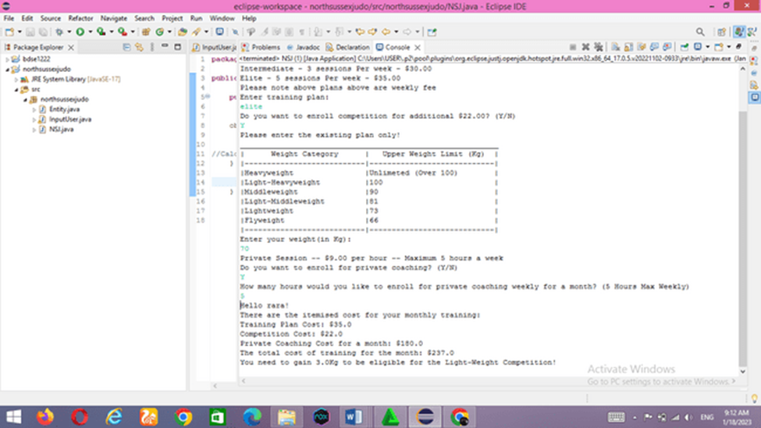
Lithan

Slide 20
13. Proposed Improvements
List of Improvements
1. When eclipse builds project, it will delete all output folders and rebuild classes built by other compilers, we can disable such features, as deleting the output foldersand rebuilding will take sometime. Go to windows-preference-Java-compiler-building
2. you could also disable eclipse automatic building, if its not needed for you. Go to project-build automatically
3. close unwated projects and use working set option to move from one group of project to another smoothly.

